Slide 1



Course : ENTR6003 – Entrepreneurship 1
Year : September 2017
“Business
Model Design (L)”
Session 11
F2F

Slide 2
LO 2: Describe the Value Propositon of the Created Business Idea LO 3: Assess the Value Proposition of the Created Business Idea
Learning Objectives

Slide 3
Sub Topics
Types of Business Model
Create Value for Your Customer and Your Business

Slide 4
Types of Business Model - REDO

Slide 5




Types of Business Model
Unbundling Business Model
The Long Tail Business Model
Multi-sided Platforms
Business Model
Free as a Business Model
Open Business Model

Slide 6
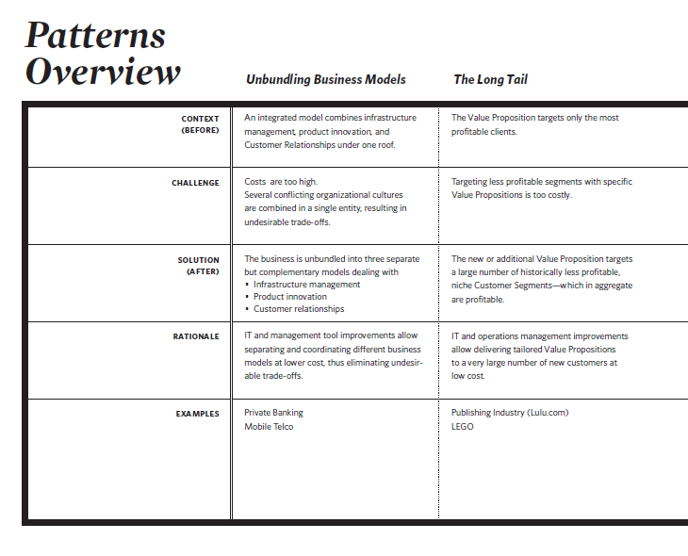
Pattern Overview

Slide 7
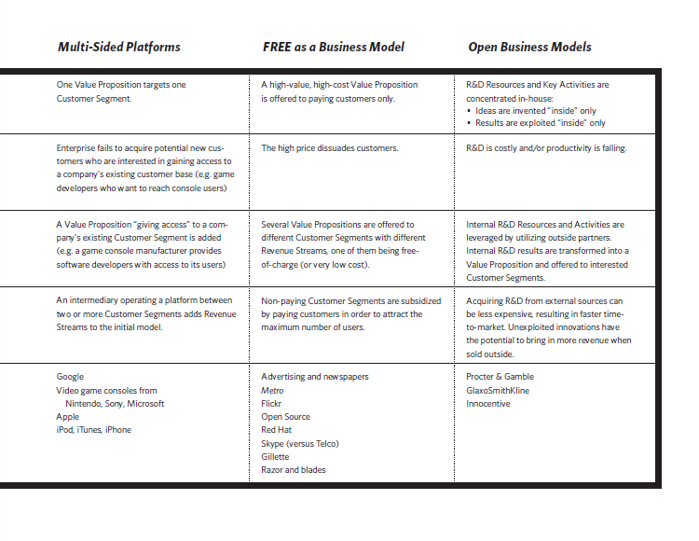
Pattern Overview (Cont’d)

Slide 8
Create Value for Your Customers and Your Business

Slide 9
Create Value for Your Customer and Your Business
To sustainably create value for your customers, you need to create value for your business
To create value for your business, you need to create value for your customer
A business that generates fewer revenue than it costs will disappear, even when the value proposition was considerably outstanding.

Slide 10




Are you creating value for your customer?
The VPC makes explicit how you are creating and capturing value for your customers.
Zoom in
Are you creating value for your business?
The BMC makes explicit how you are creating and capturing value for your business.
Zoom Out

Slide 11
References
Alexander O, Yves P, Greg B, and Alan S (2014), Value Proposition Design. John Wiley & Co, New Jersey. ISBN: 978-1-118-96805

